Slide 1
Gauss-Seidel Method
B.4

Slide 2
Gauss-Seidel Method
An iterative method.
Basic Procedure:
Algebraically solve each linear equation for x_{i}
Assume an initial guess solution array
Solve for each x_{i} and repeat
Use absolute relative approximate error after each iteration to check if error is within a pre-specified tolerance.

Slide 3
Gauss-Seidel Method
Why?
The Gauss-Seidel Method allows the user to control round-off error.
Elimination methods such as Gaussian Elimination and LU Decomposition are prone to round-off error.
Also: If the physics of the problem are understood, a close initial guess can be made, decreasing the number of iterations needed.

Slide 4



Gauss-Seidel Method
Algorithm
A set of n equations and n unknowns:
If: the diagonal elements are non-zero
Rewrite each equation solving for the corresponding unknown
ex:
First equation, solve for x₁
Second equation, solve for x₂
. .
. .
. .

Slide 5
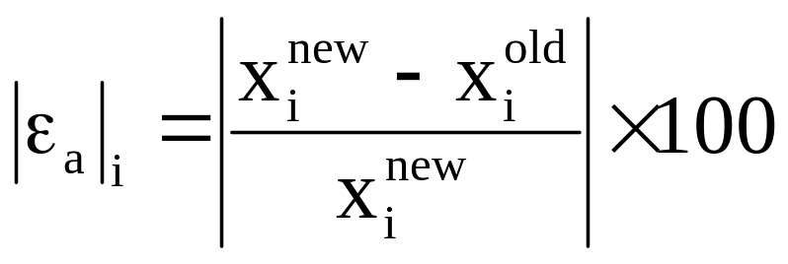
Gauss-Seidel Method
Calculate the Absolute Relative Approximate Error
So when has the answer been found?
The iterations are stopped when the absolute relative approximate error is less than a prespecified tolerance for all unknowns.

Slide 6

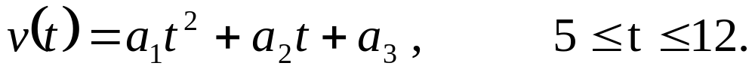
Gauss-Seidel Method: Example 1
The upward velocity of a rocket is given at three different times
Time, t | Velocity, v
s | m/s
5 | 106.8
8 | 177.2
12 | 279.2
The velocity data is approximated by a polynomial as:

Slide 7
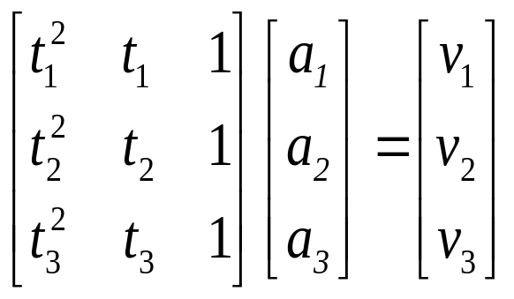
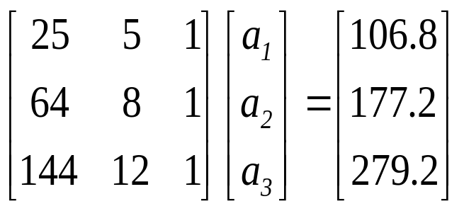
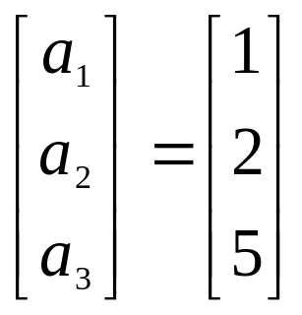
Gauss-Seidel Method: Example 1
Using a Matrix template of the form
The system of equations becomes
Initial Guess: Assume an initial guess of

Slide 8
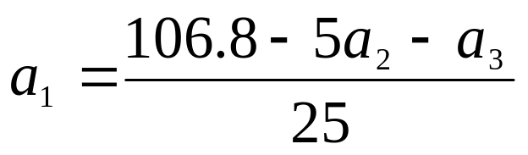
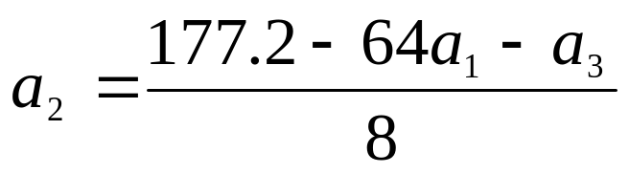
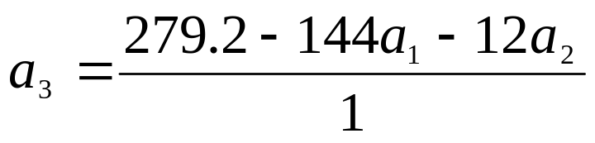
Gauss-Seidel Method: Example 1
Rewriting each equation

Slide 9
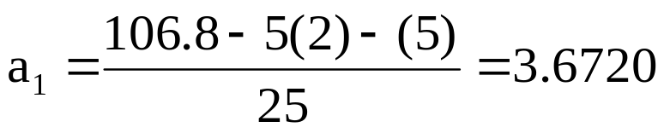
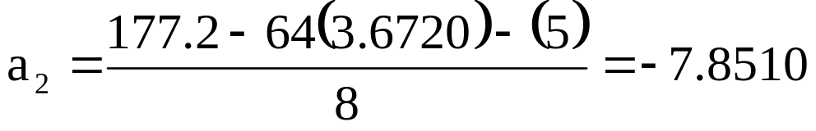
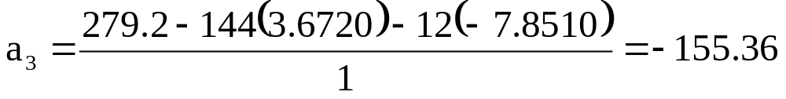
Gauss-Seidel Method: Example 1
Applying the initial guess and solving for a_{i}
Initial Guess
When solving for a₂, how many of the initial guess values were used?

Slide 10
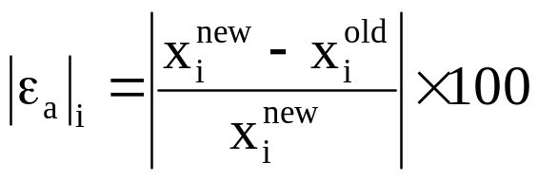
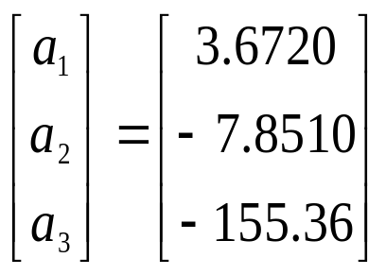
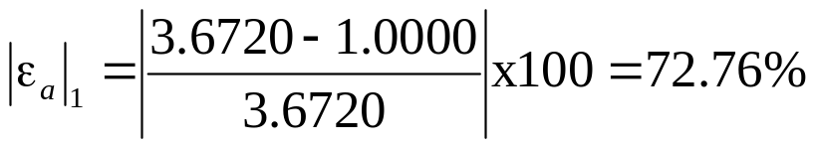
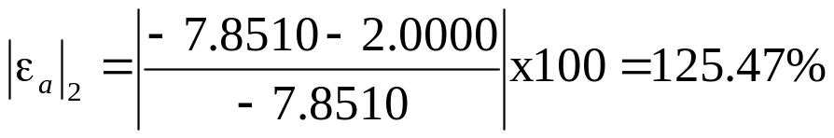
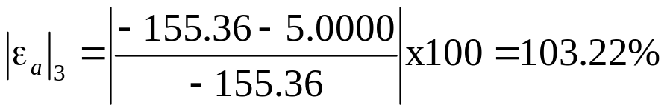
Gauss-Seidel Method: Example 1
Finding the absolute relative approximate error
At the end of the first iteration
The maximum absolute relative approximate error is 125.47%

Slide 11
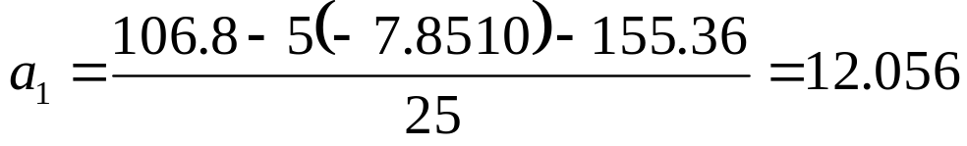
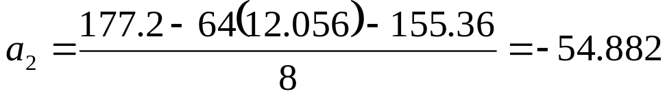
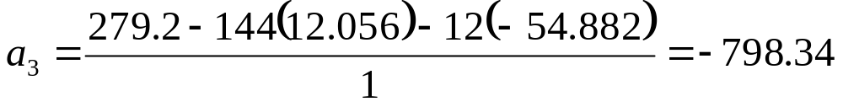
Gauss-Seidel Method: Example 1
Iteration #2
Using
the values of a_{i} are found:
from iteration #1

Slide 12
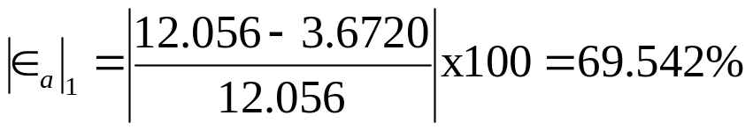
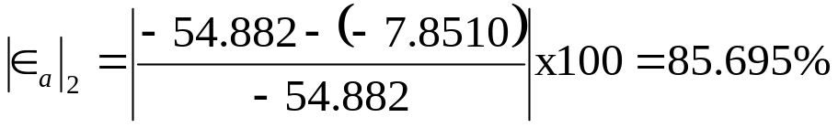
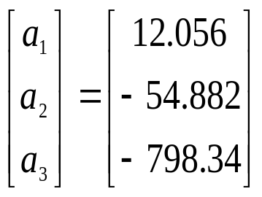
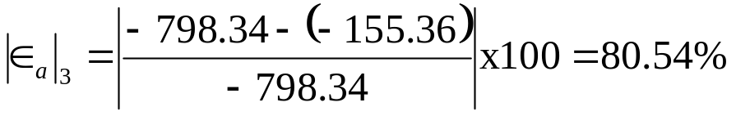
Gauss-Seidel Method: Example 1
Finding the absolute relative approximate error
At the end of the second iteration
The maximum absolute relative approximate error is 85.695%

Slide 13


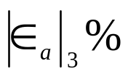
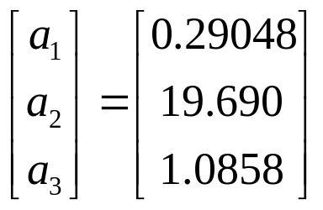
Gauss-Seidel Method: Example 1
Repeating more iterations, the following values are obtained
Iteration | a₁ |  | a₂ |  | a₃
1 2 3 4 5 6 | 3.672 12.056 47.182 193.33 800.53 3322.6 | 72.767 67.542 74.448 75.595 75.850 75.907 | -7.8510 -54.882 -255.51 -1093.4 -4577.2 -19049 | 125.47 85.695 78.521 76.632 76.112 75.971 | -155.36 -798.34 -3448.9 -14440 -60072 -249580 | 103.22 80.540 76.852 76.116 75.962 75.931
! Notice – The relative errors are not decreasing at any significant rate
Also, the solution is not converging to the true solution of

Slide 14
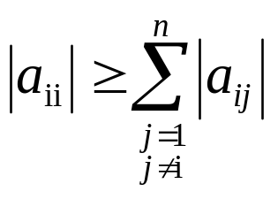
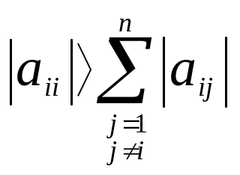
Gauss-Seidel Method: Pitfall
What went wrong?
Even though done correctly, the answer is not converging to the correct answer
This example illustrates a pitfall of the Gauss-Siedel method: not all systems of equations will converge.
Is there a fix?
One class of system of equations always converges: One with a diagonally dominant coefficient matrix.
Diagonally dominant: [A] in [A] [X] = [C] is diagonally dominant if:
for all ‘i’ and
for at least one ‘i’

Slide 15
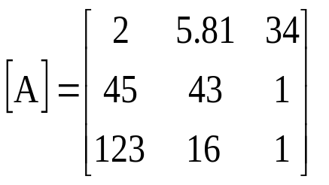
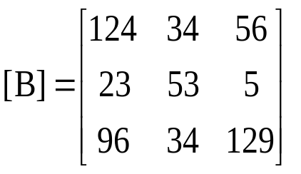
Gauss-Seidel Method: Pitfall
Diagonally dominant: The coefficient on the diagonal must be at least equal to the sum of the other coefficients in that row and at least one row with a diagonal coefficient greater than the sum of the other coefficients in that row.
Which coefficient matrix is diagonally dominant?
Most physical systems do result in simultaneous linear equations that have diagonally dominant coefficient matrices.

Slide 16

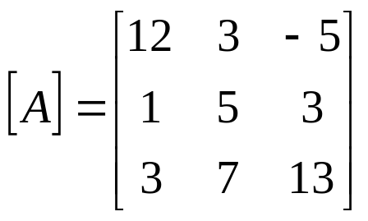


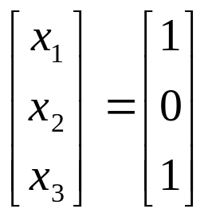
Gauss-Seidel Method: Example 2
Given the system of equations
The coefficient matrix is:
With an initial guess of
Will the solution converge using the Gauss-Siedel method?

Slide 17
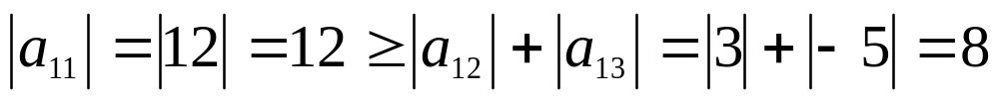
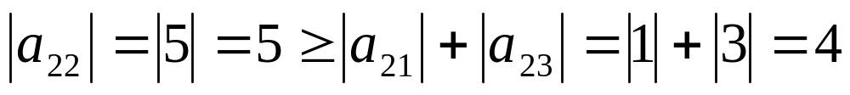
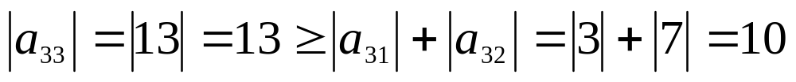
Gauss-Seidel Method: Example 2
Checking if the coefficient matrix is diagonally dominant
The inequalities are all true and at least one row is strictly greater than:
Therefore: The solution should converge using the Gauss-Siedel Method

Slide 18
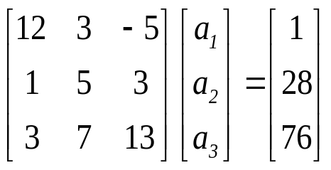
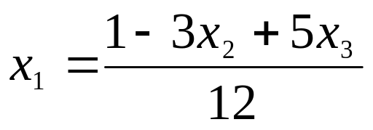
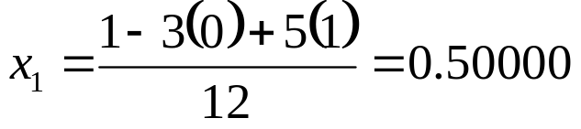
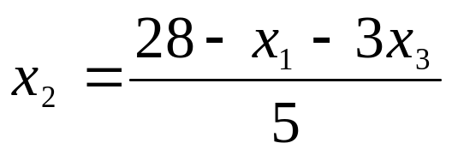
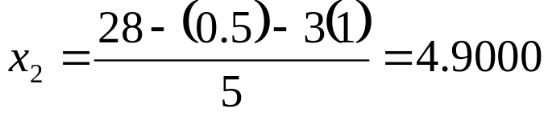
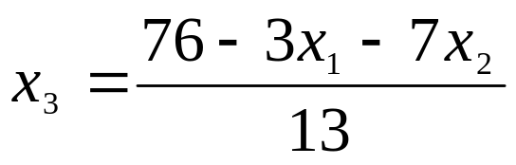
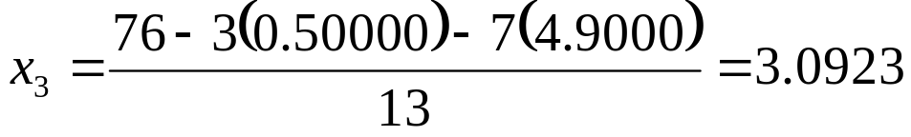
Gauss-Seidel Method: Example 2
Rewriting each equation
With an initial guess of

Slide 19
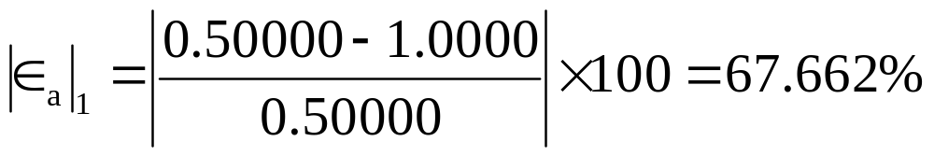
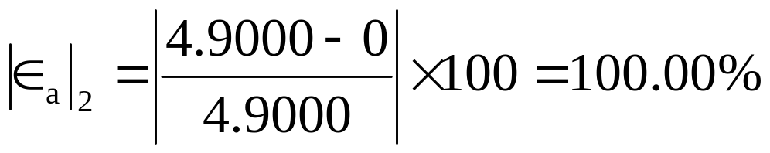
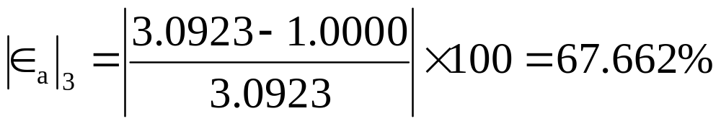
Gauss-Seidel Method: Example 2
The absolute relative approximate error
The maximum absolute relative error after the first iteration is 100%

Slide 20
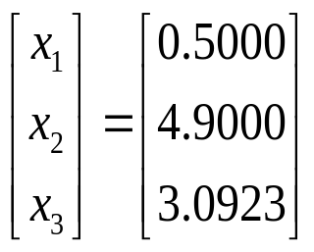
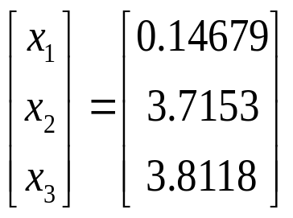
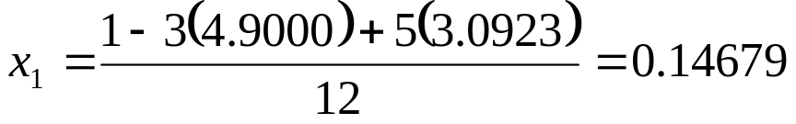
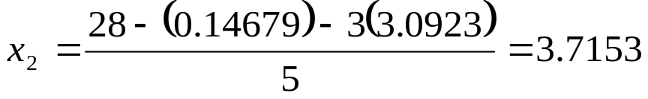

Gauss-Seidel Method: Example 2
After Iteration #1
Substituting the x values into the equations
After Iteration #2

Slide 21
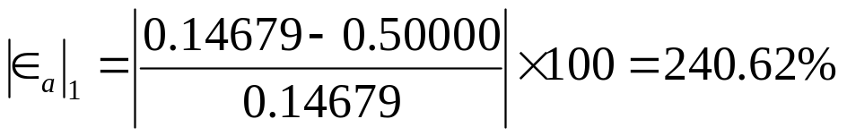
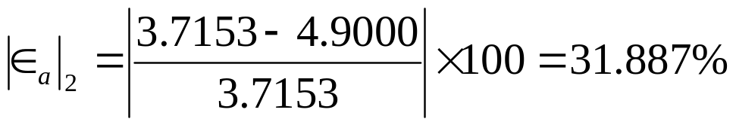

Gauss-Seidel Method: Example 2
Iteration #2 absolute relative approximate error
The maximum absolute relative error after the first iteration is 240.62%
This is much larger than the maximum absolute relative error obtained in iteration #1. Is this a problem?

Slide 22





Gauss-Seidel Method: Example 2
Repeating more iterations, the following values are obtained
Iteration | a₁ |  | a₂ |  | a₃
1 2 3 4 5 6 | 0.50000 0.14679 0.74275 0.94675 0.99177 0.99919 | 67.662 240.62 80.23 21.547 4.5394 0.74260 | 4.900 3.7153 3.1644 3.0281 3.0034 3.0001 | 100.00 31.887 17.409 4.5012 0.82240 0.11000 | 3.0923 3.8118 3.9708 3.9971 4.0001 4.0001 | 67.662 18.876 4.0042 0.65798 0.07499 0.00000
The solution obtained
is close to the exact solution of

Slide 23







Gauss-Seidel Method: Example 3
Given the system of equations
Rewriting the equations
With an initial guess of

Slide 24



Gauss-Seidel Method: Example 3
Conducting six iterations
Iteration | a₁ |  | a₂ |  | a₃
1 2 3 4 5 6 | 21.000 -196.15 -1995.0 -20149 2.0364x10⁵ -2.0579x10⁵ | 110.71 109.83 109.90 109.89 109.90 1.0990 | 0.80000 14.421 -116.02 1204.6 -12140 1.2272x10⁵ | 100.00 94.453 112.43 109.63 109.92 109.89 | 5.0680 -462.30 4718.1 -47636 4.8144x10⁵ -4.8653x10⁶ | 98.027 110.96 109.80 109.90 109.89 109.89
The values are not converging.
Does this mean that the Gauss-Seidel method cannot be used?

Slide 25

Gauss-Seidel Method
The Gauss-Seidel Method can still be used
The coefficient matrix is not diagonally dominant
But this is the same set of equations used in example #2, which did converge.
If a system of linear equations is not diagonally dominant, check to see if rearranging the equations can form a diagonally dominant matrix.

Slide 26



Gauss-Seidel Method
Not every system of equations can be rearranged to have a diagonally dominant coefficient matrix.
Observe the set of equations
Which equation(s) prevents this set of equation from having a diagonally dominant coefficient matrix?

Slide 27
Gauss-Seidel Method
Summary
Advantages of the Gauss-Seidel Method
Algorithm for the Gauss-Seidel Method
Pitfalls of the Gauss-Seidel Method

Slide 28
Gauss-Seidel Method
Questions?

